Slide 1
Text Summarization
by
Kaixi Tan
Cs 688

Slide 2
Content
Download and create corpus from multiple documents
Visually display the most frequent words and perform content analysis to rank
Determine the number of “topics” and the “number” of most important sentences that provide best summarization for each document
Visually highlight by hand the summary sentences in the full text

Slide 3
Download and create corpus
Find some interested topics from ted talk
Use third party subtitle download web(downsub.com)
Create and corpus

Slide 4
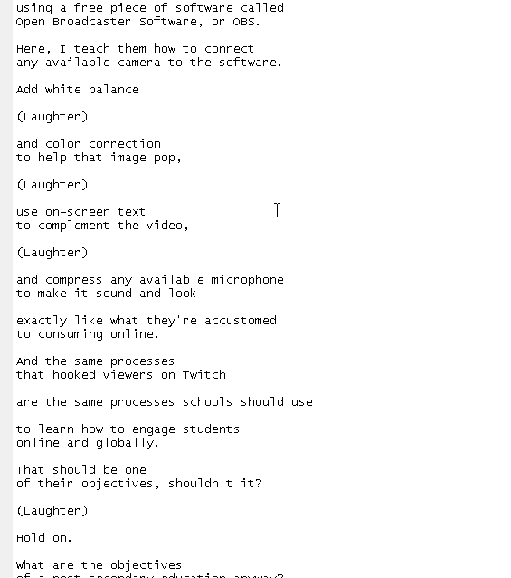
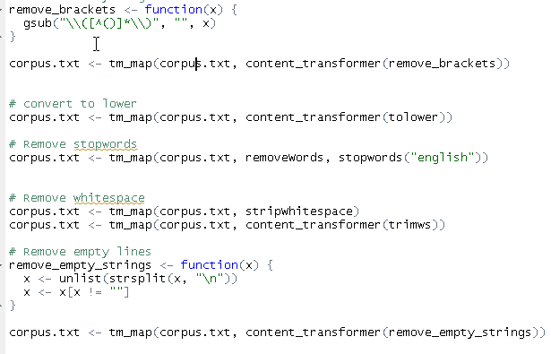
Clean corpus
Frequently appear but useless (e.g. laught, cheer)
Convert to lower (word frequency)
Remove some stopwords, whitespace, empty lines

Slide 5
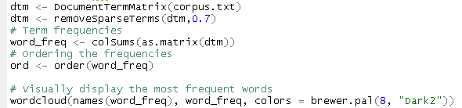

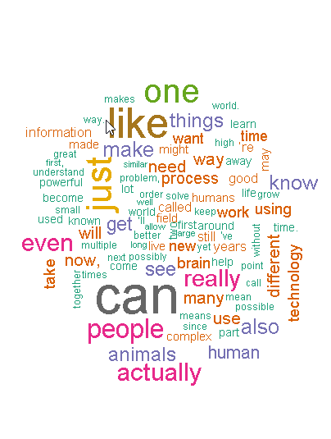
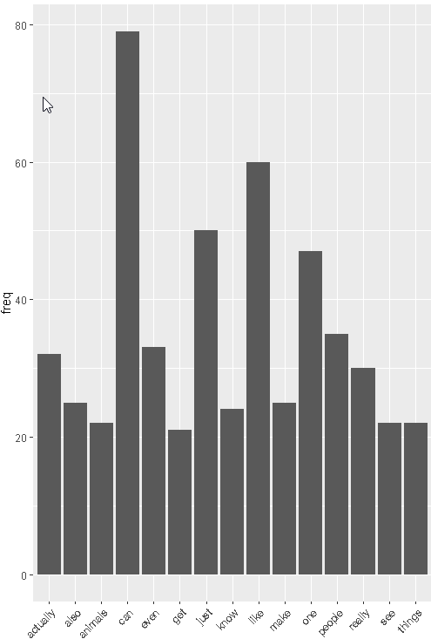
Visually display the frequent words
Word cloud
Histogram

Slide 6
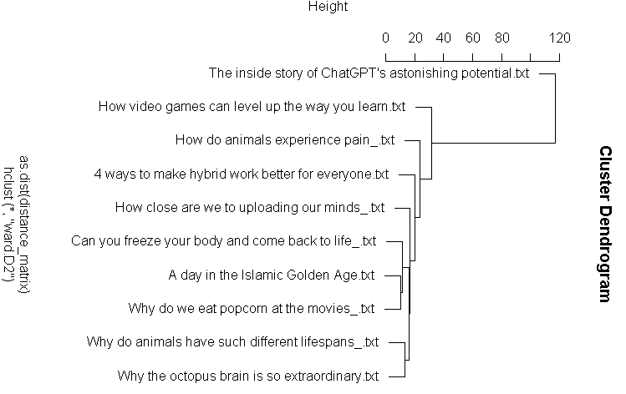

Perform content analysis to rank
Hierarchical clustering
relationship
similarly
cluster
Result

Slide 7
Text summary
Use provided Document Summarization code
Number of Sentences
Depedent on the length of the text
Usually choose 5%-20% of the length text
Number of Topics
perplexity values

Slide 8
Perplexity values
Perplexity is a measurement of how well a probability distribution model predicts a sample.
Lower mean better
LDA model
By document length, choose the topic range (2:8)
Test all topic range find the Minimum

Slide 9
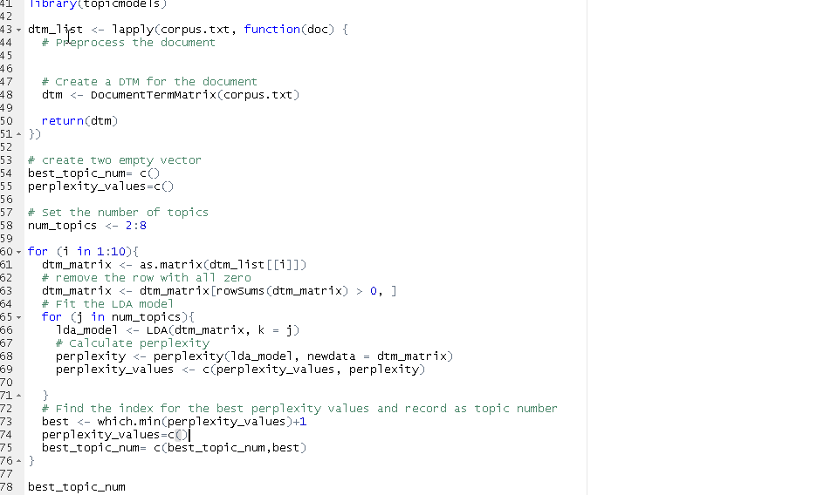

Slide 10
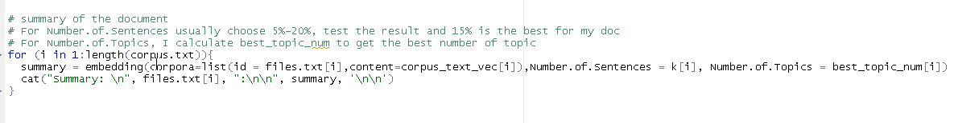
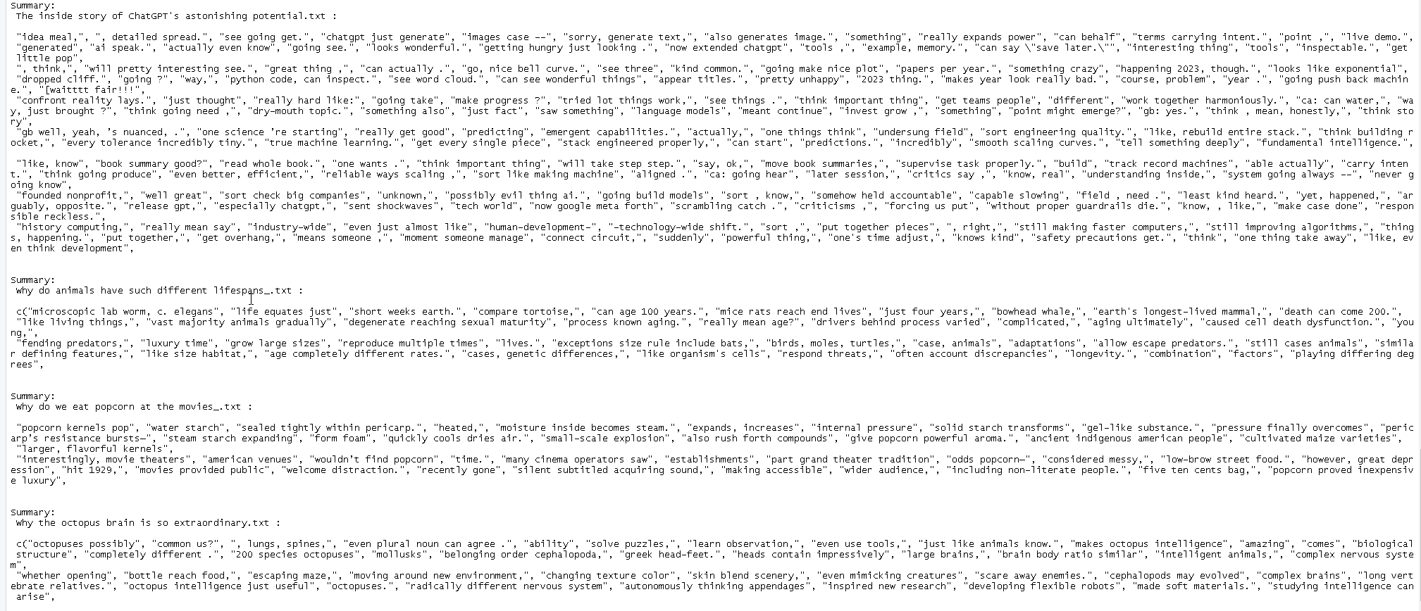
The summary for each document
Input all the value
print out

Slide 11
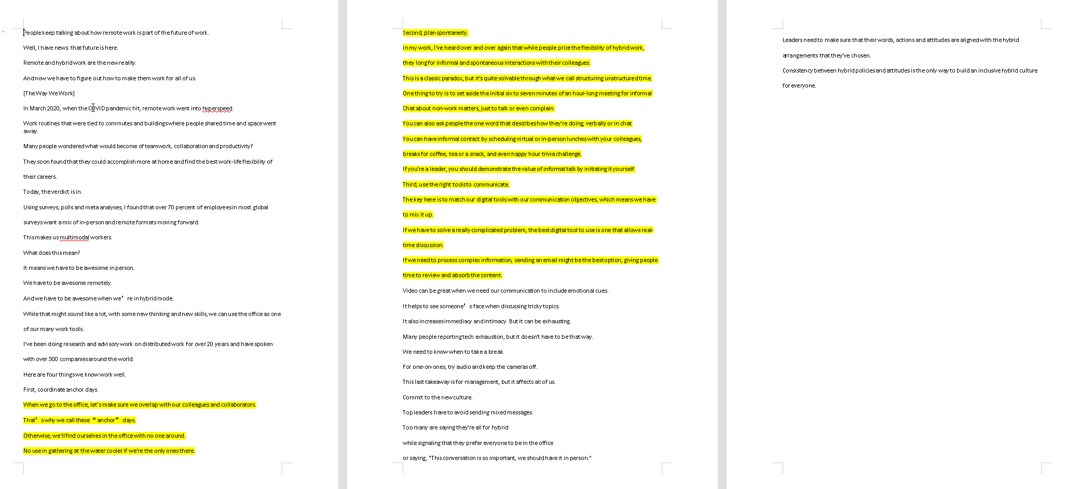
Visually highlight by hand

Slide 12
Thanks for listening

